Slide 1
Making a positive impact: A step by step process
By: Abby Azbell

Slide 2
My plan / End goals
I sit with a few of my friends at lunch but the one I haven’t met prior to this semester, I want to become friends with
She is very quiet and reserved but seems sweet when talking with her friends
My plan is to take steps closer to get closer with her

Slide 3
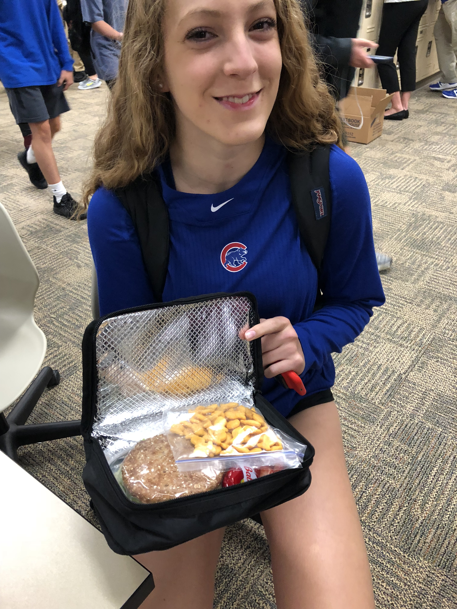
Step 1 Making her lunch
She would always come to school and never ate and I didn’t know why
Stole others peoples food so I just made Chloe her own lunch

Slide 4
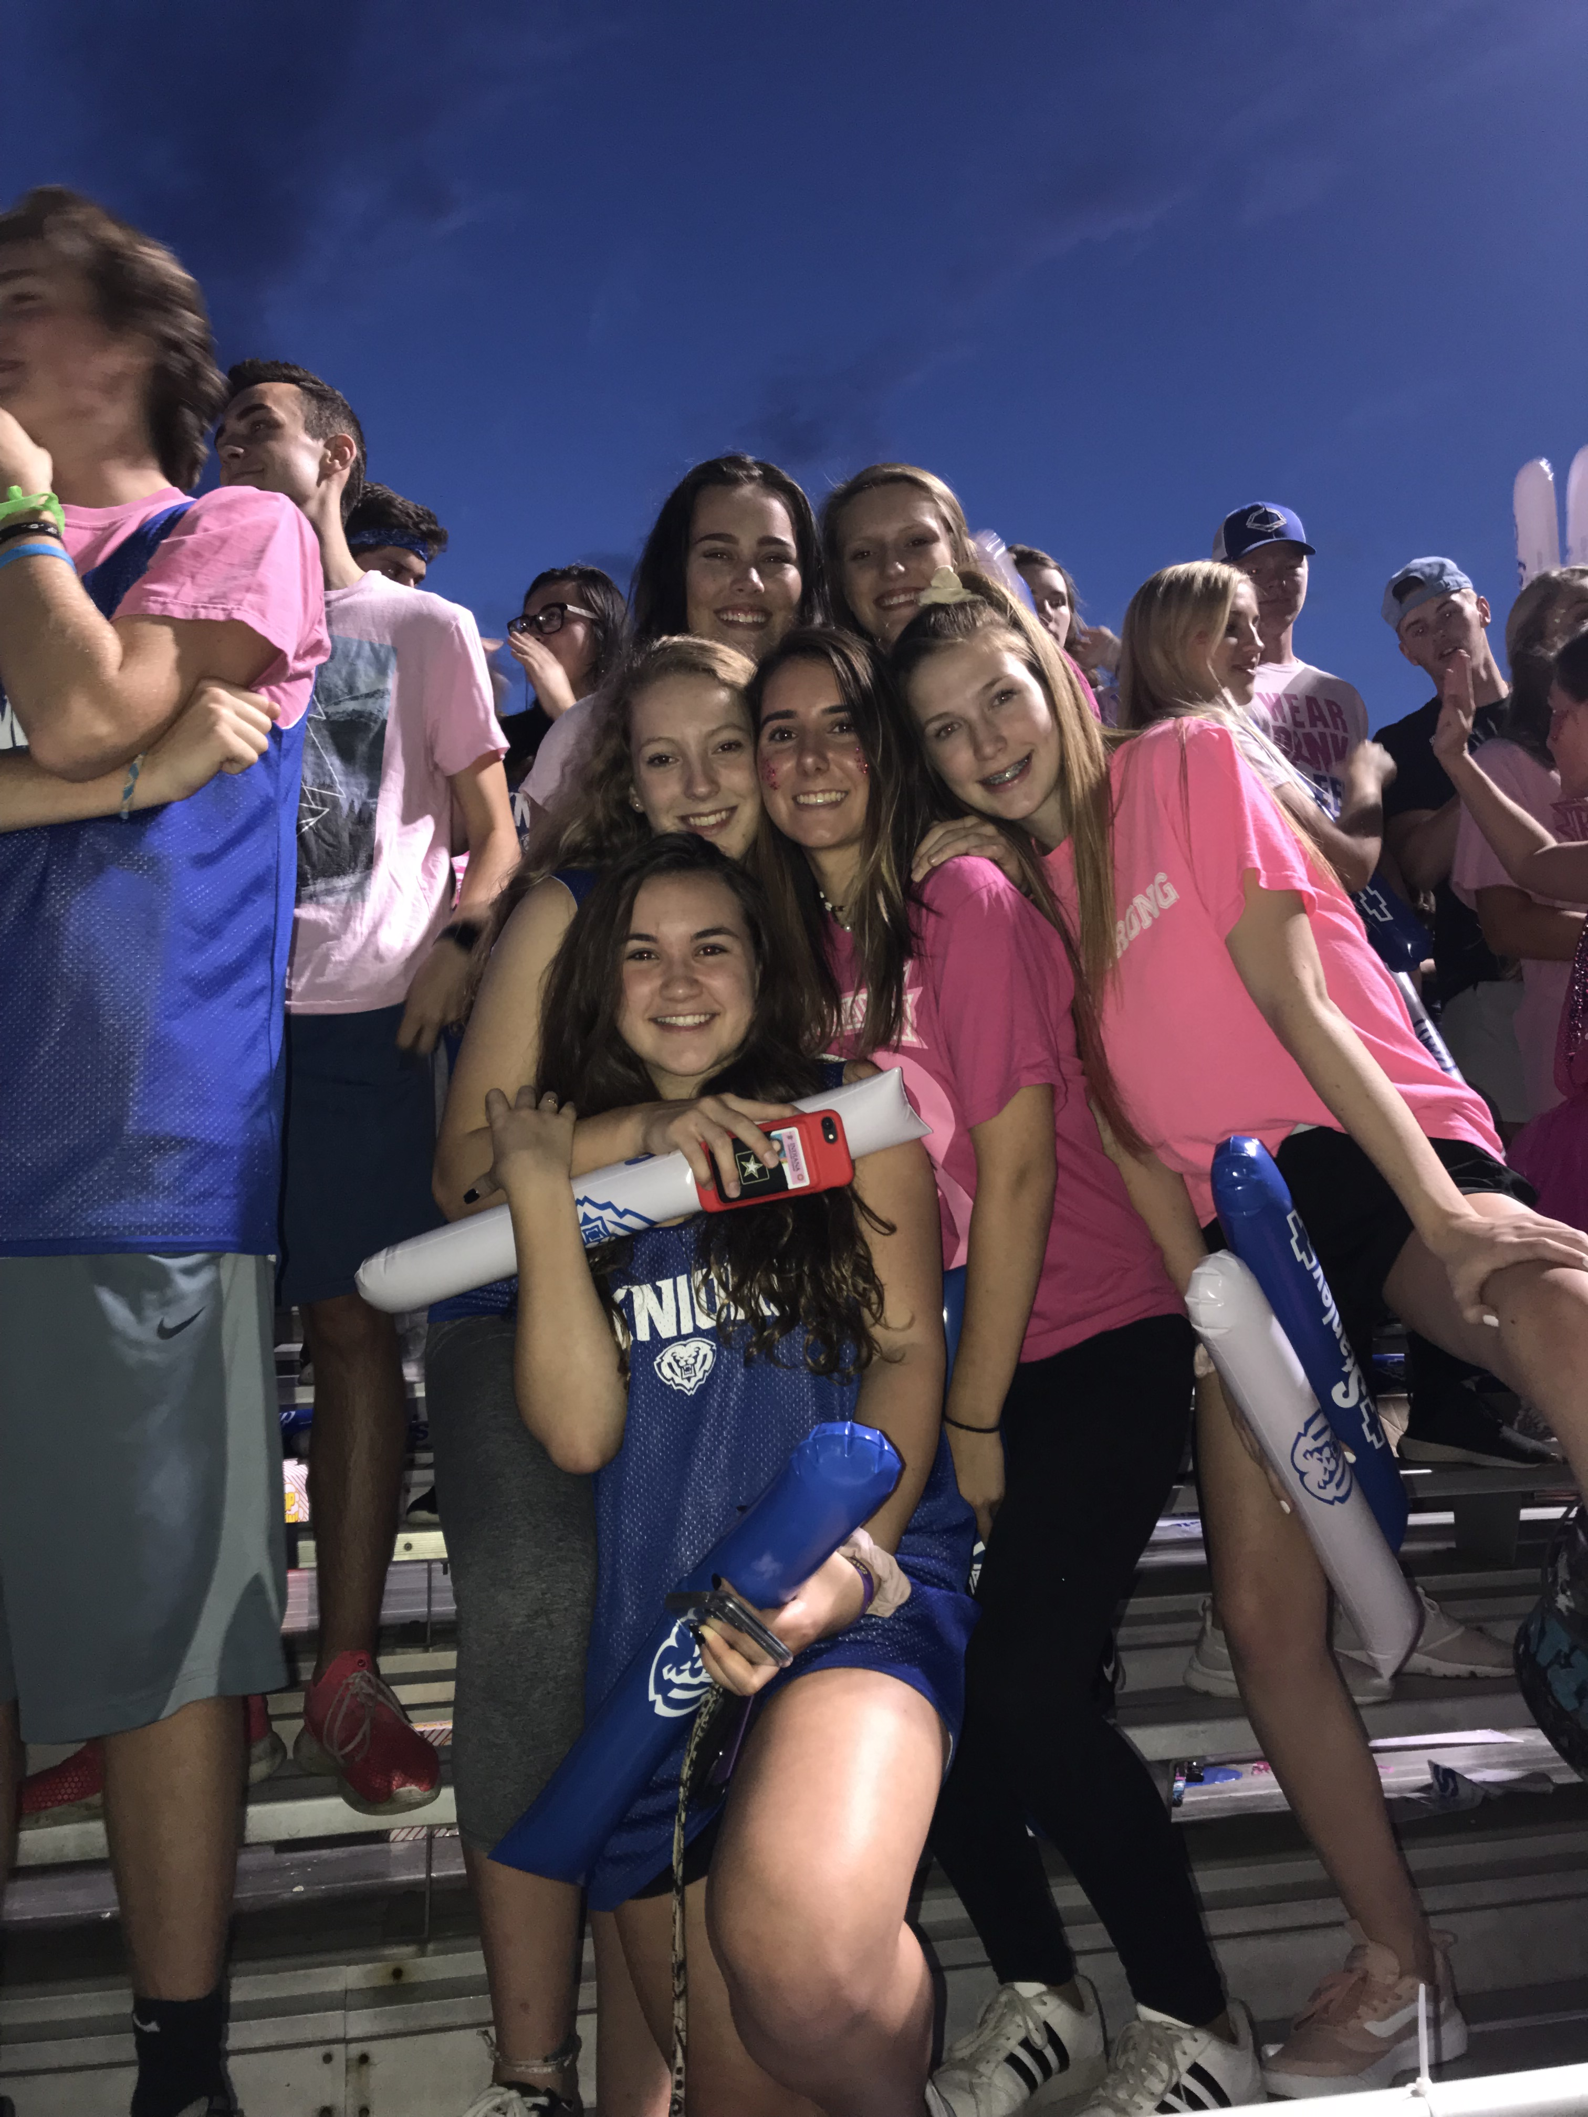
Step 2 Hanging out – the football game
I wanted to get to know her better and neither of us had to been to a football game
We ended up having a lot of mutual friends

Slide 5
Step 3 giving her a letter and gifts
I wanted to give her a letter on how much our friendship had impacted my life in the past couple weeks
I also got her a big teddy bear from Amazon

Slide 6
How did pushed me out of my comfort zone
This pushed me out of my comfort zone because I had to talk to and form a relationship with a stranger which was difficult for me

Slide 7
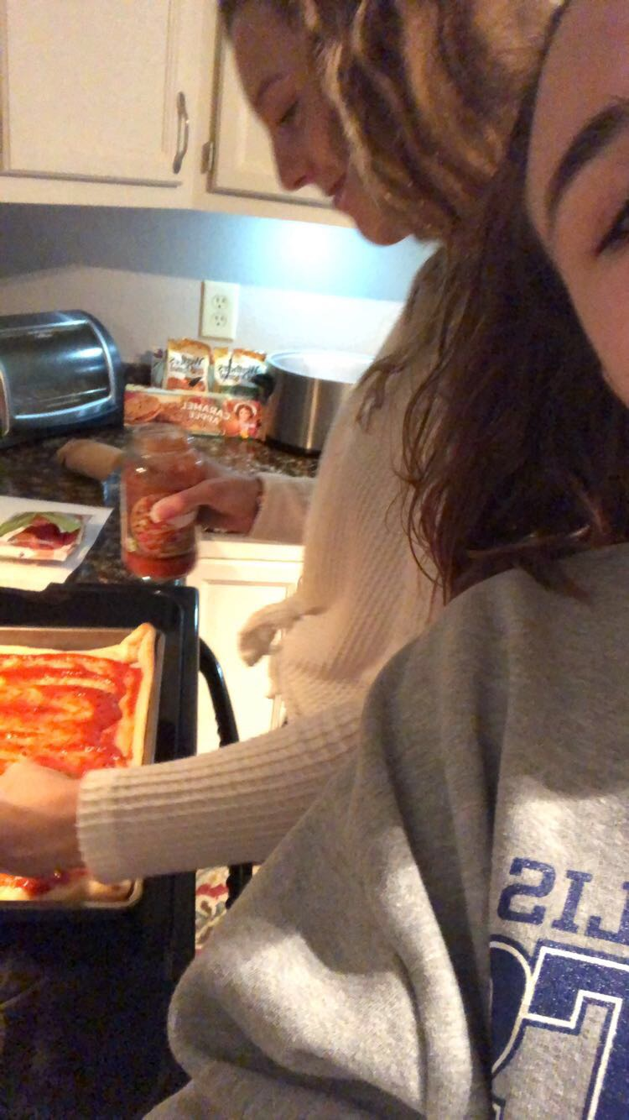
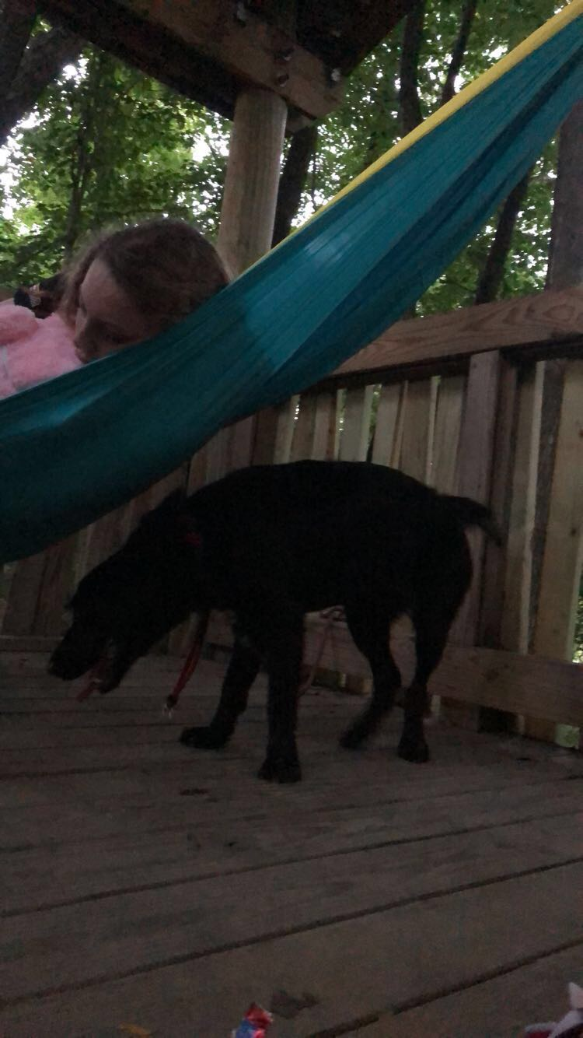
How it impacted Chloe and I
I believe it both impacted us in the same way
We both grew closer to become one of each others best friends
We are inseparable now

